Slide 1

Pump it up:
How thermally driven heat pumps can help decarbonise heating
Starting soon…

Slide 2
Welcome!
Your camera and microphone are off
You can ‘react’ using the buttons
During the Q&A, ask questions using the chat function
For more info: www.ehpa.org and www.ehi.eu

Slide 3
Agenda and speakers:
Introduction:
Thomas Nowak, EHPA Secretary General; Federica Sabbati, EHI Secretary General
The technology:
Gerrit Füldner, Head of Team Sorption Technology at Fraunhofer Institute Solar Energy Systems (ISE)
The panel discussion:
Steven Ashurst, Head of heat at LCP Delta (moderator)
Eric Lecomte, Policy Officer Innovation, Research, Digitalisation, and Competitiveness, EU Commission
Mario Motta, Associate professor on building physics and building energy systems at Politecnico di Milano
Luigi Tischer, Senior Director R&D at Ariston
Gideon Blij, R&D manager, ATAG Verwarming BV
Andreas Lücke, Senior Expert, Bundesverband der Deutschen Heizungsindustrie (BDH)

Slide 4
Introduction

Slide 5
Presentation of the technology

Slide 6
What are Thermally Driven Heat Pumps (TDHP)?
And why do we need them?

Slide 7
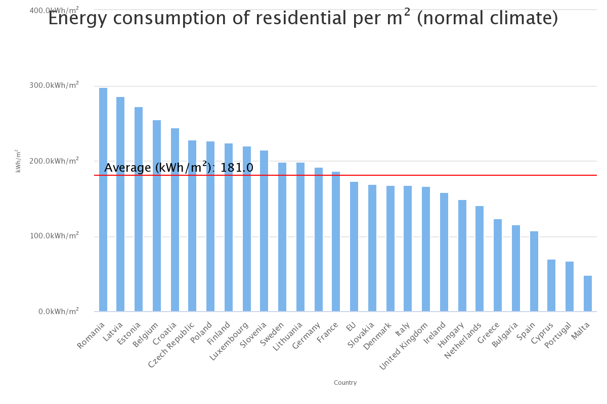
Current situation and challenge: Example Italy, heating energy
TDHP
EHP
*
Source: EU Buildings Datamapper | Energy (europa.eu)

Slide 8
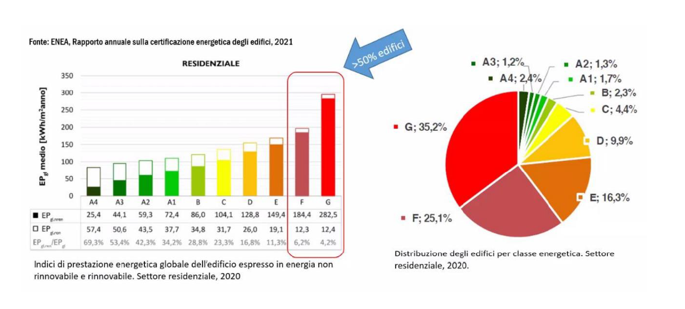
Current situation and challenge: Example Italy, buildings
TDHP
EHP
*

Slide 9
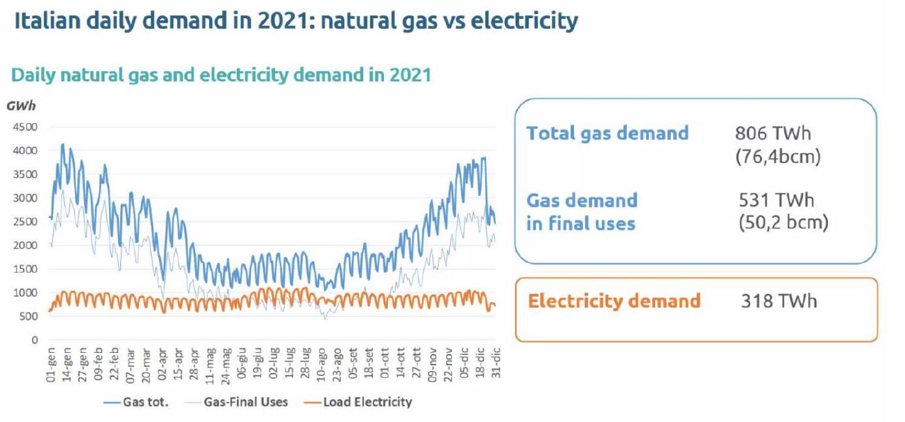
Current situation and challenge: Example Italy, gas and electricity
TDHP
EHP
*

Slide 10
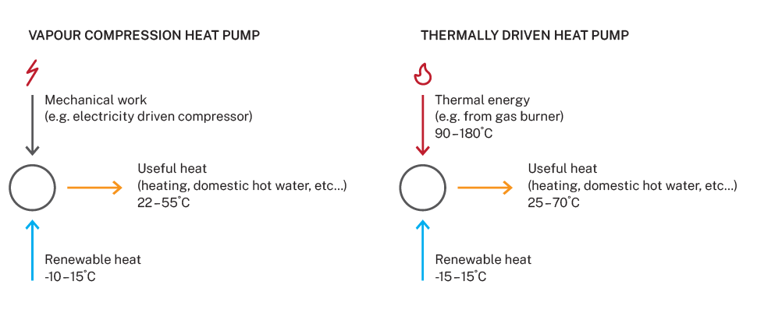
Heat pumps: not only electricity as possible source
TDHP
EHP
*

Slide 11
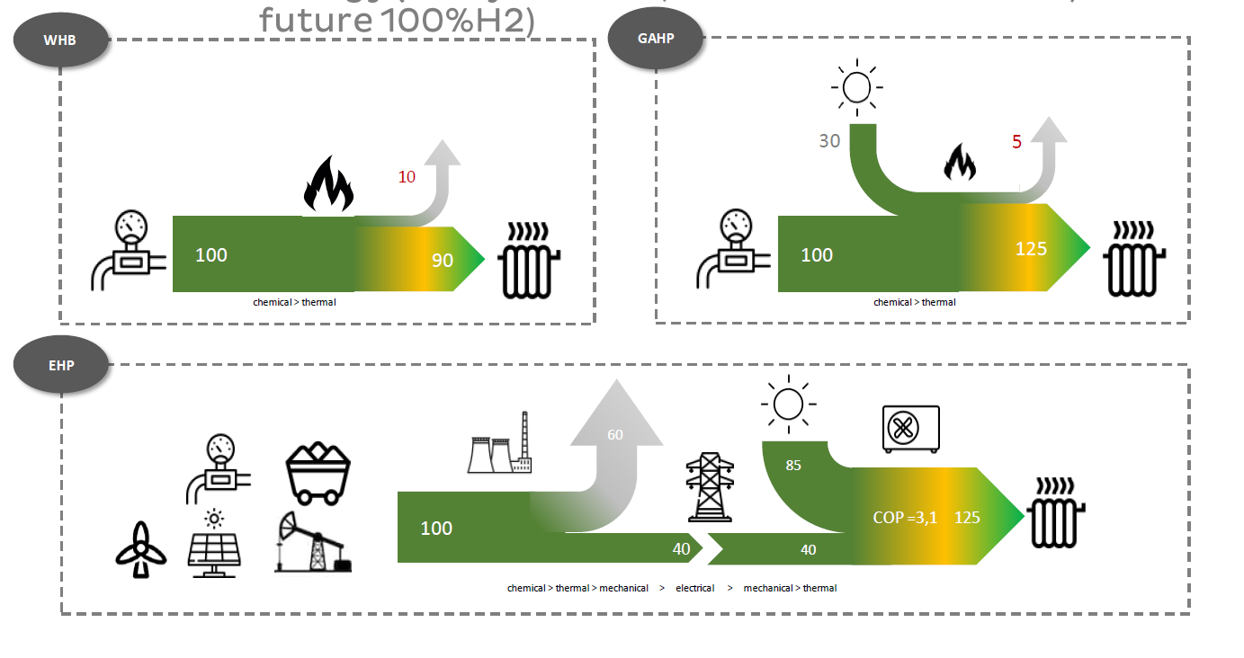
TDHP
EHP
*
*depending on primary energy ratio, here 2.5: currently varying between about 1.5 to 3.5 for different countries and seasons

Slide 12

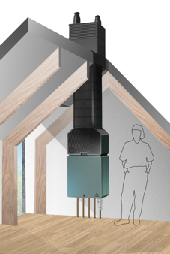

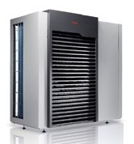

Several TDHP Technology Options
ABsorption
      Liquid solution is continually circulated
      Natural refrigerant (ammonia-water solution), GWP 0
      Usually directly fired generator
      Most commercially-mature TDHP option
ADsorption
      Batch process switching between adsorption and desorption.
      Natural refrigerant (ammonia-active carbon), GWP 0
      More easily configured as hybrid solution (heat pumping only in part load, high loads directly by gas condensing boiler)
      Currently in field tests
Source: Robur
Source: Cooll
Source: Ariston
Source: Elco
Source: Remeha

Slide 13
Challenges
  Similar challenges to EHP – e.g. space for outdoor units, regulations around the use of certain working fluids / refrigerants
  Form factor / footprint – can be larger than competing options
  Product and fully-installed costs – based on current level of maturity & production volumes
  Perception among policy makers – ‘gas is the past’...!
  End-user and installer / specifier awareness – lots of awareness raising needed
*Also ‘renewable gas’, ‘decarbonised gas’, ‘green gas’, ‘biomethane’, ‘green hydrogen’...

Slide 14
Key: Flexibility and Retrofitability
  TDHP link intimately efficient technologies of condensing boiler and heat pump (the “ultimate hybrid”)
  TDHP are suitable for high temperature heating systems e.g. with radiators
  TDHP reduce use of fuel (-30-40% compared to CB) and add renewable energy
  TDHP make use of existing energy infrastructure
  TDHP use 100% renewable energy, if fully powered by biogas
*Also ‘renewable gas’, ‘decarbonised gas’, ‘green gas’, ‘biomethane’, ‘green hydrogen’...

Slide 15
Let‘s discuss!

Slide 16
Panel discussion and Q&A

Slide 17

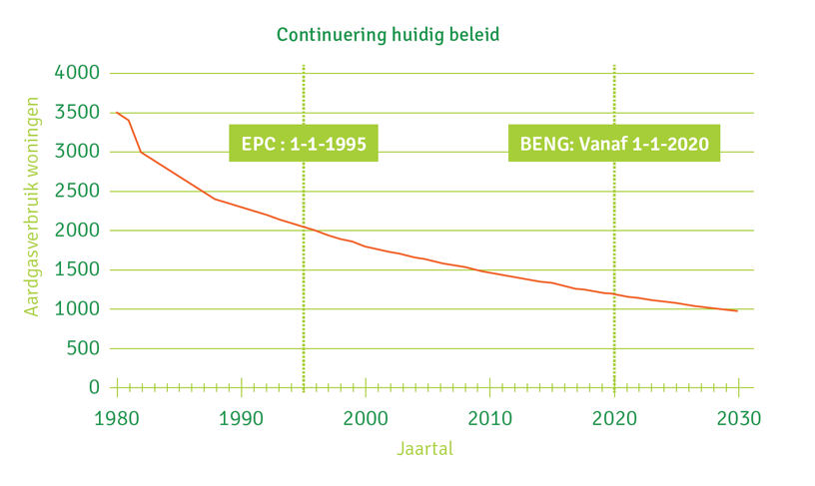
BioNet
Reduce energy utilization dwelling:
Increasing diversity of types of gas:
Autonomy
Competitivity
Sustainability
EPC
BENG
Green gas
EU and world market
LNG-G25.3
Russian gas
Norwegian gas
Small fields
EU, NL energy policy
Groningen
1963
2011

Slide 18
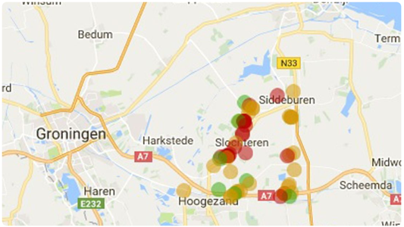
2016: Energy agenda Dutch Economic department
POLICY DUTCH GOVERNMENT -> REDUCTION CO2
2017: major earthquake in Groningen, 2,6
Political decision stop gas production Groningen
2018 legislation changed, no obligation for distribution network
operator to connect to gas. -> equals ban gas in new build
2019 climate covenant -> Local government fill out on district level heating system (RES).
POLICY DUTCH GOVERNMENT ->
- 2030, 1,5 Mio dwellings disconnected gas, 35 TWH renewable (PV+wind), 2 BCM Greengas
- 2050, climate neutral

Slide 19
Q1- 2021, project “aardgasvrije wijken” (NG free residential area’s), only 4 of the 27 projects disconnected gas grid
  Execute cost neutral for end-user was not possible
  No motivation end-user and no legal option to force the change
Q2- 2021, policy adjustment government to speed up energy transition, hybrids as intermediate solution or final. Based on covenant between Dutch Government, NGO (natuur&beheer), Installer association (techniek Nederland), heating industry (DHPA and NVI).
  2024 Covenant installed hybrids realize additionally 125.000 installed hybrids.
  2026, no mono boiler allowed for the replacement market, only hybrids or equal technology.

Slide 20
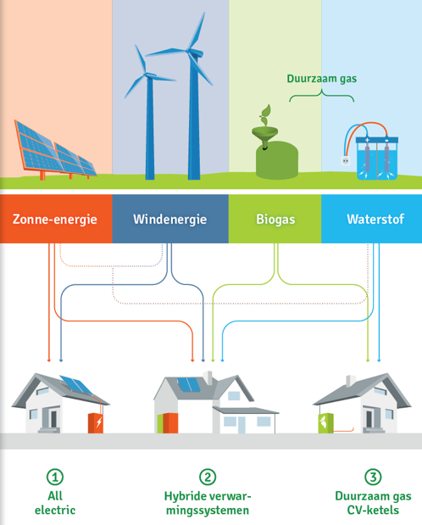
Convenant
  Stimulate customer behaviour
  Isolate buildings
  Apply efficient heating instlations
    District heating
    All electric
    Hybride heating systems
  (green) Gas is part of the (end) solution to reduce CO2 footprint
  But how to regulate that efficient products reach the market?

Slide 21
Quickfire poll:
www.slido.com → #3237945

Slide 22
Thank you for attending!
www.ehpa.org and www.ehi.eu

